Slide 2

Microbial Archaeology
Dr. Irina Velsko and Zandra Fagernäs

Slide 3

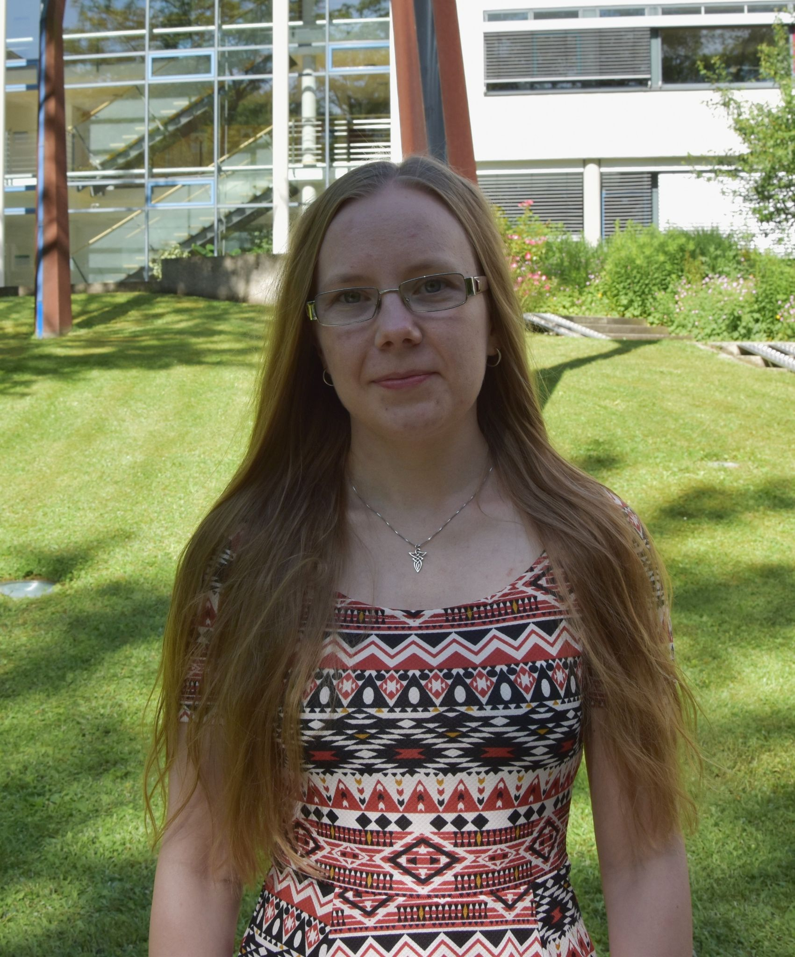
Who are we?
Irina
Zandra
Has a Ph. D. in microbiology
Works with dental calculus
Also knows about living microbes
Genetics, proteomics, metabolomics
Is trying to get a Ph. D. in microbiology
Works with dental calculus
Does a lot of lab work
Genetics, proteomics

Slide 4
Is anyone working with ancient microbes?
Planning a project with ancient microbes?
Think ancient microbes are cool?
Write in the chat!

Slide 5
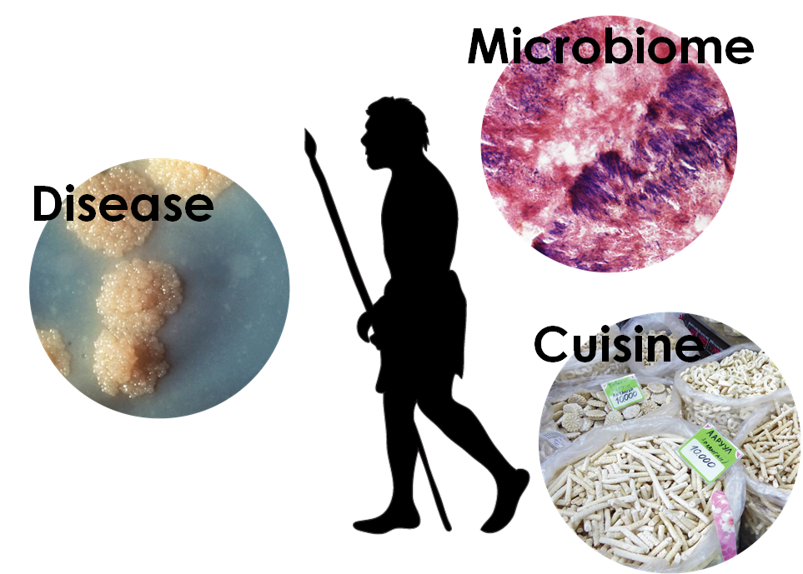
Why study microbes?
Notes:
What can we learn? Health and disease (pandemics), diet and cultural practices, food preparation. Will mainly focus on pathogens and microbiomes today.

Slide 6
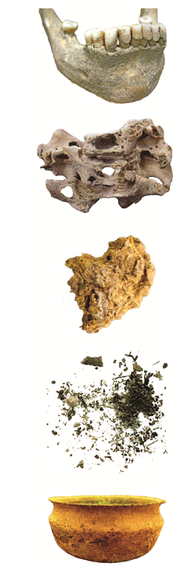
Where can you find ancient microbes?
Notes:
Microbes are everywhere around us. We consist of about as many microbial cells as human cells. Where we can find ancient microbes: Teeth and calculus, bones, palaeofaeces, pot crusts.

Slide 7
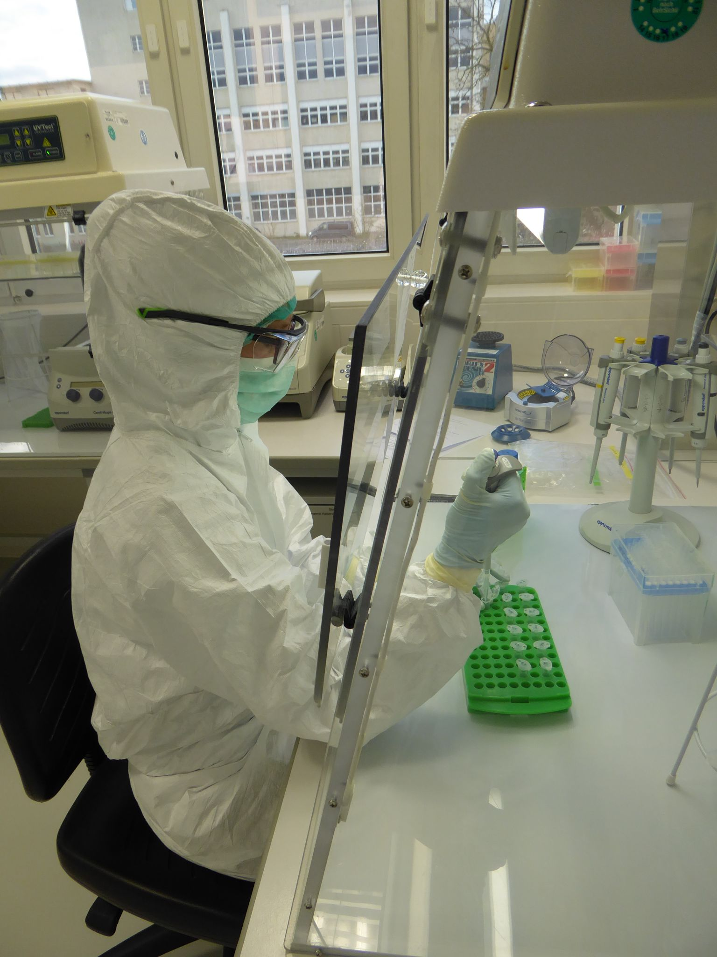
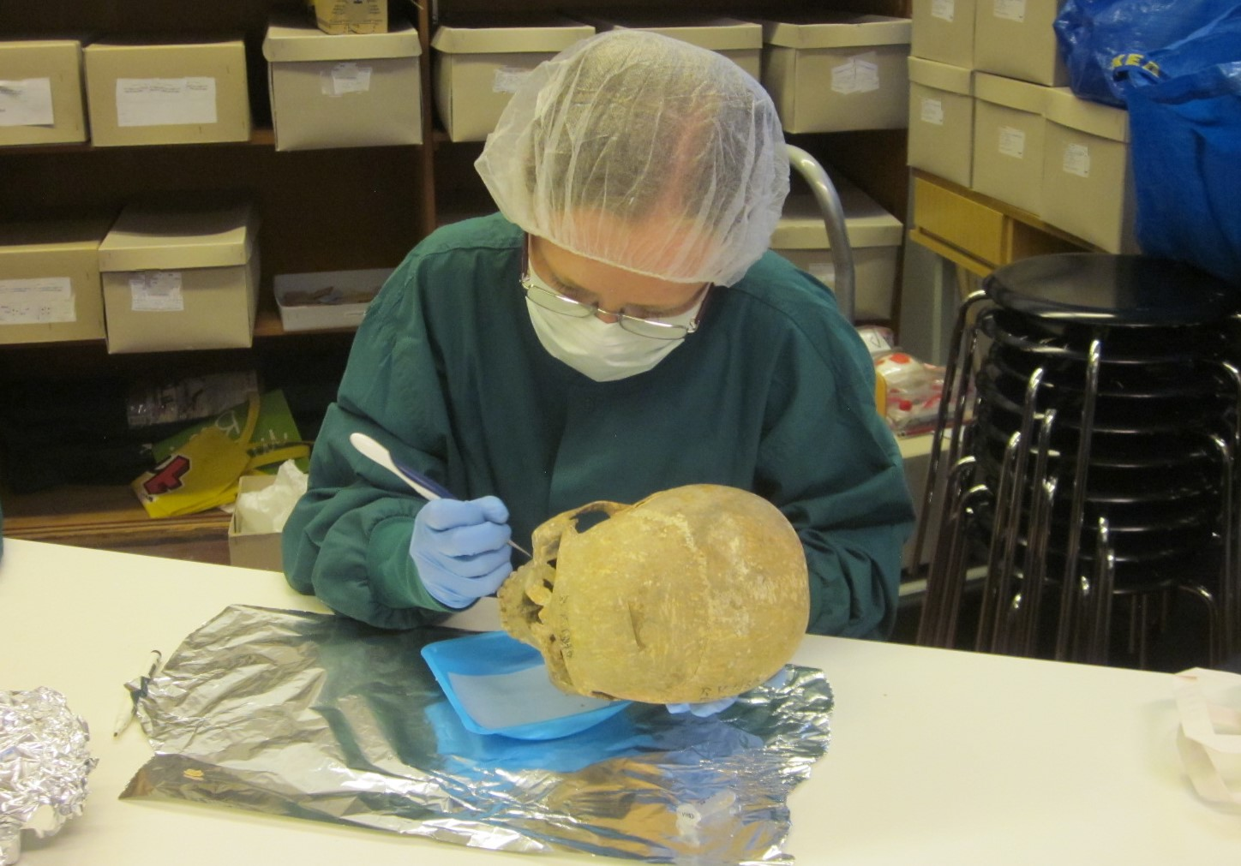
Microbes are everywhere!!!
Notes:
Easy to have contamination in the lab and from microbes all around us

Slide 9
Past pathogens
Changes in human lifestyle exposed us to new pathogens
Domesticated animals
Higher population densities
Mobility
Epidemics and disease outbreaks have been recorded
Cause is often unknown
Traditionally researched through palaeopathology of skeletal assemblages
In the 1990s, aDNA came into the picture
First genome published in 2011 (Yersinia pestis)

Slide 10
What pathogens?
Bacteria
Brucella melitensis (brucellosis)
Gardnerella vaginalis (bacterial vaginosis)
Helicobacter pylori (GI ulcers)
Mycobacterium leprae (leprosy)
Mycobacterium tuberculosis (tuberculosis)
Tannerella forsythia (periodontal disease)
Treponema pallidum (syphilis/jaws/bejel)
Vibrio cholerae (cholera)

Slide 11
What pathogens?
Viruses
HBV (viral hepatitis)
HIV (AIDS)
Influenza virus (influenza)
VARV (smallpox)
Eukaryotes
Phytophthora infestans (potato blight)
Plasmodium falciparum and Plasmodium vivax (malaria)

Slide 12
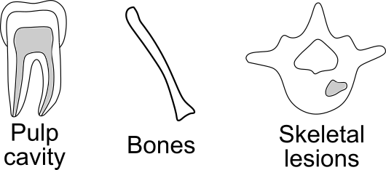
Where can we find pathogens?
Notes:
Many are transported around the body in the bloodstream. Pulp cavity more protected than bones postmortem.

Slide 13
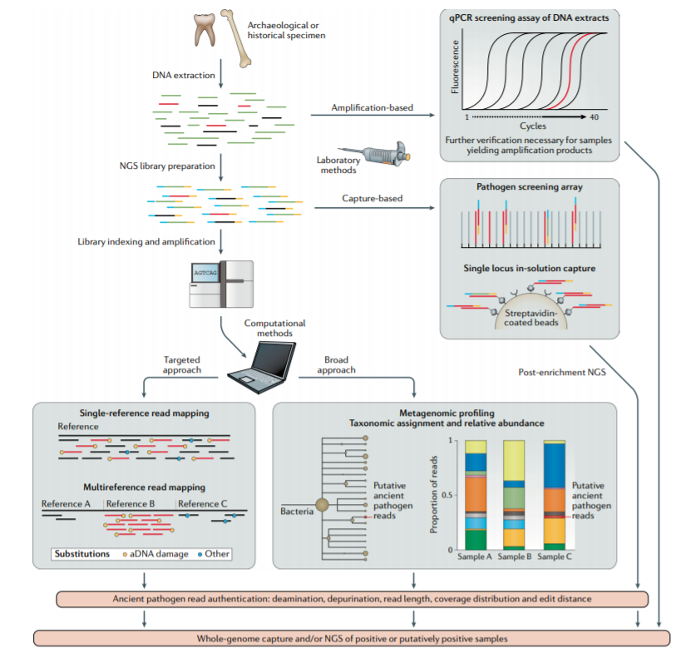
Ancient pathogens
Spyrou et al. 2019 Nat Rev Genet.

Slide 14
Ancient pathogens
Spyrou et al. 2019 Nat Rev Genet.

Slide 15
Ancient pathogens
Spyrou et al. 2019 Nat Rev Genet.

Slide 16
Plague
Cocolitzli

Slide 17
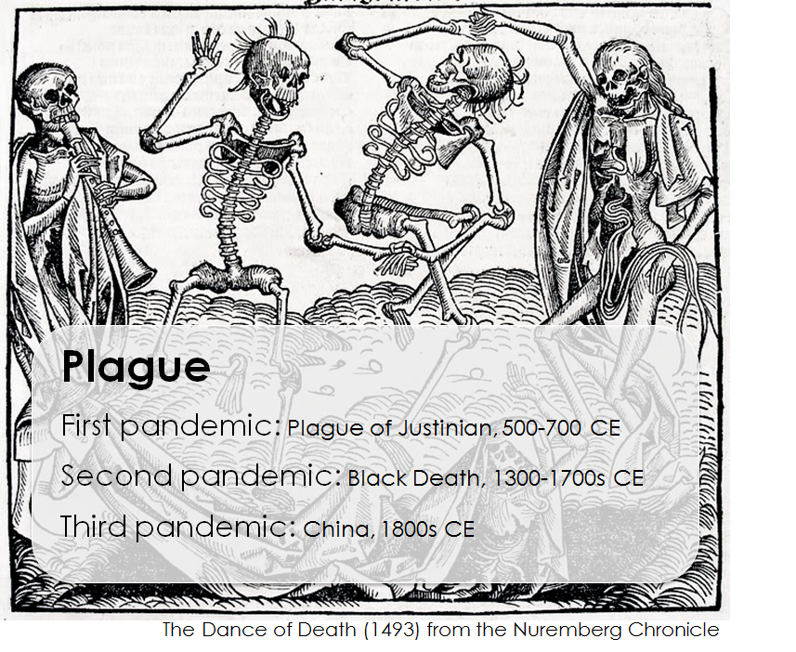

Slide 18
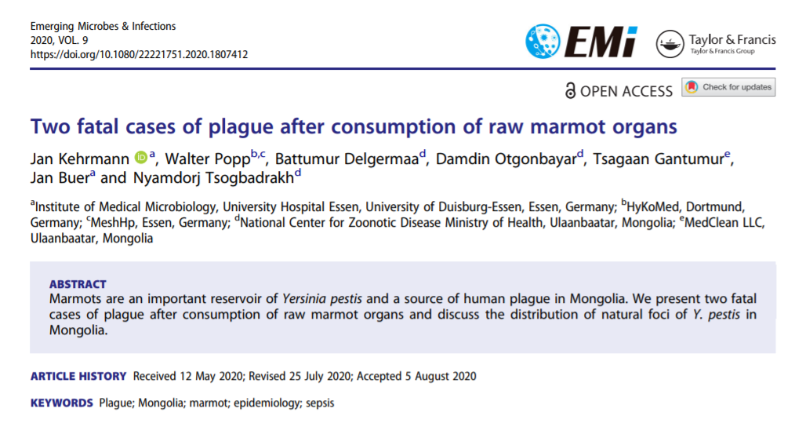

Slide 19
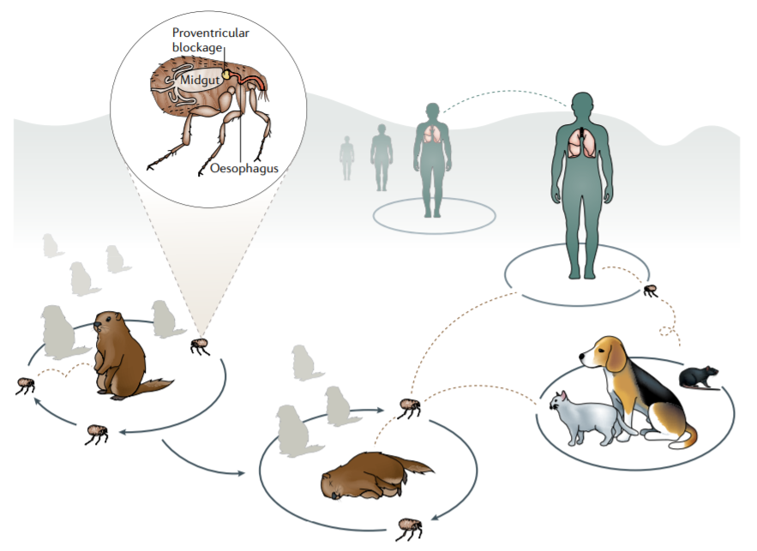
Yersinia pestis
Not human-adapted
Maintained in wild rodents
Still has active foci
Transmitted by fleas
Blocks gut
Flea feeds more
Spyrou et al. 2019 Nat Rev Genet.
Notes:
Yersinia population maintained in wild rodents. Unknown how it jumps to humans - pets? Consuming rodents?

Slide 20
Plague in humans
Bubonic
Most common
Bacteria travel to lymph nodes, cause ‘buboes’
Up to 60% mortality if untreated
2. Pneumonic
Bacteria have travelled to the lungs
Human-to-human transmission
Nearly to 100% mortality if untreated
3. Septicaemic
Spreading in the bloodstream
Nearly to 100% mortality if untreated

Slide 21
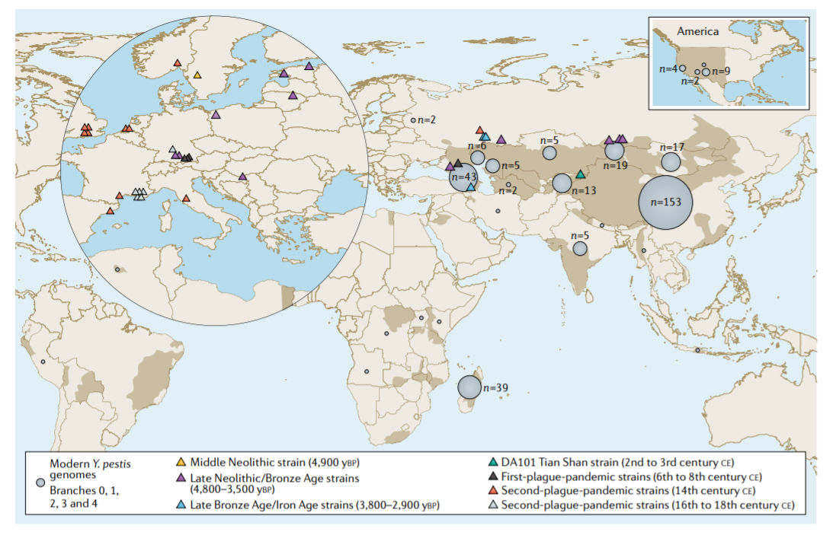
Yersinia pestis genomes
Spyrou et al. 2019 Nat Rev Genet.
Notes:
38 published ancient genomes in 2019. Many more now.

Slide 22
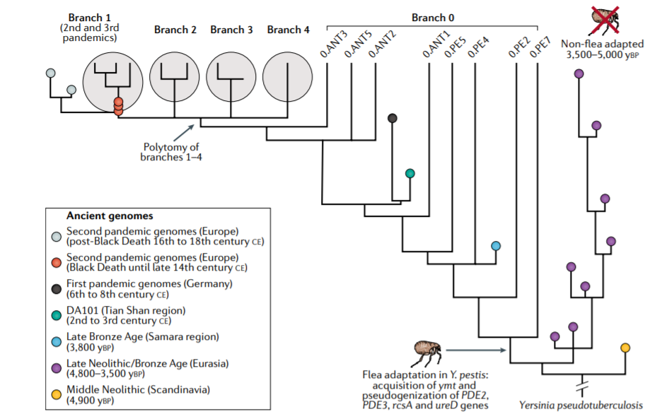
Yersinia pestis aDNA
Spyrou et al. 2019 Nat Rev Genet.
Notes:
Emerged from Y. pseudotuberculosis 13000-79000 YBP (hard to date). Human remains Neolithic and Bronze Age -> at least 5000 years old.

Slide 23
Yersinia pestis aDNA
Not flea-adapted
Not bubonic
How was plague transmitted?
What was the host population?
Spread mirrors human migrations
Spyrou et al. 2019 Nat Rev Genet.

Slide 24
Yersinia pestis aDNA
Spyrou et al. 2019 Nat Rev Genet.

Slide 25
Yersinia pestis aDNA
Spyrou et al. 2019 Nat Rev Genet.

Slide 26
Yersinia pestis summary
By studying ancient genomes we have learned about
Transmission
Virulence
Evolution
Notes:
Perhaps lessons for current/future pathogens. Still much to learn, more genomes continuously being sequenced.

Slide 27
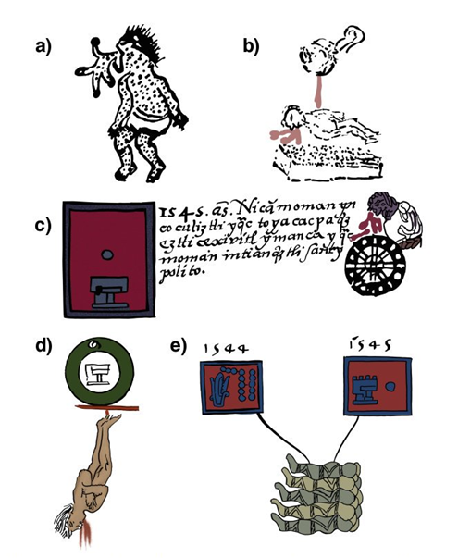
Cocolitzli
Poorly understood epidemic, mortality 60-90%
During 16th century, started in Central Mexico
Many indigenous sources depicting the epidemic
No certainty on what the cause was
Typhoid fever
Epidemic typhus
Plague
Influenza
Hemorrhagic fever
Notes:
Means ‘pestilence’ in Nahuatl, an Aztec language. One of three 16th c pandemics in the area. Post-European contact. Poor living conditions and overwork. New pathogens. Food shortage and insufficient medical care.

Slide 28
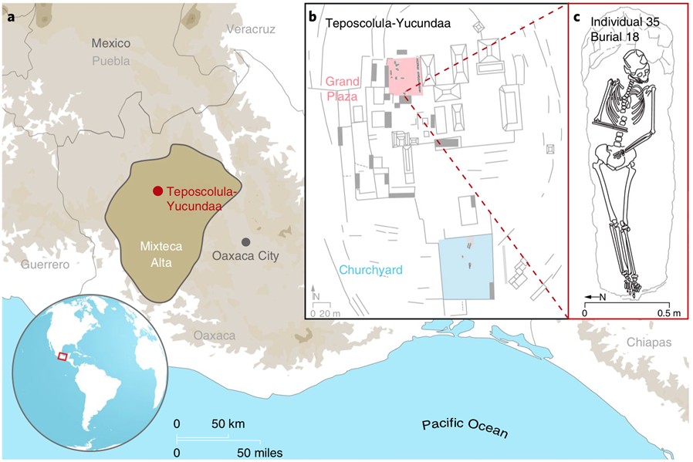
Cocolitzli-associated burial
Vågene et al. 2018 Nat Ecol Evol.
Notes:
Taxonomic screening of shotgun sequenced DNA from a Mixtec site in Mexico. Both pre- and post-contact era burials.

Slide 29
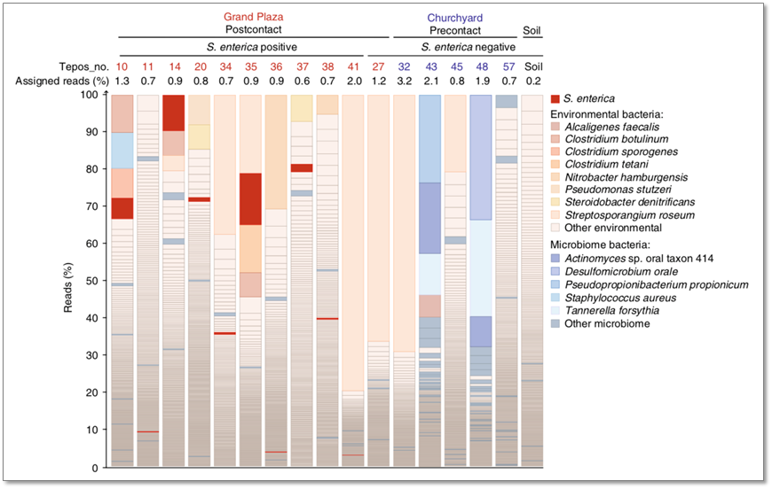
Metagenomic screening
Vågene et al. 2018 Nat Ecol Evol.
Notes:
Taxonomic screening. Samples were teeth. Salmonella only present post-contact. Soil samples included for control.

Slide 30
Cocolitzli-causing bacterium?
Salmonella enterica subsp. enterica serovar Paratyphi C
Enteric fever
Infected individuals shed bacteria after symptoms have ended
Asymptomatic carriers
Little is known about the past of this disease
Notes:
Actual cause is still debated. More data is needed.

Slide 31
Cocolitzli summary
First molecular evidence of what may have caused the epidemic
More research needed
We can start to solve ancient mysteries using aDNA
Connected with other lines of evidence
Notes:
Actual cause is still debated. More data is needed.

Slide 32
Notes:
I added an intro slide to keep things cohesive

Slide 33
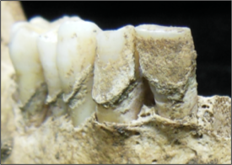
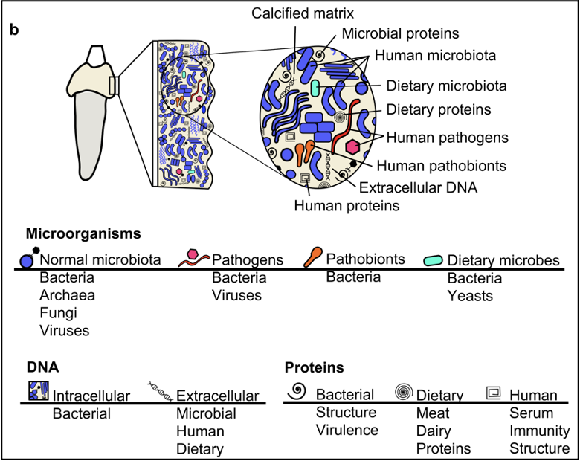
What is a microbiome?
Historic dental calculus (~200 years old)
Modified from Velsko and Warinner 2017 Bioarchaeology International

Slide 34


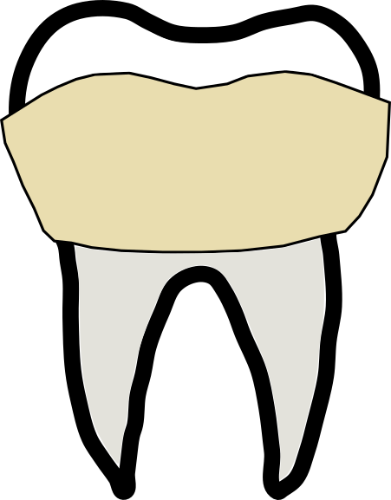


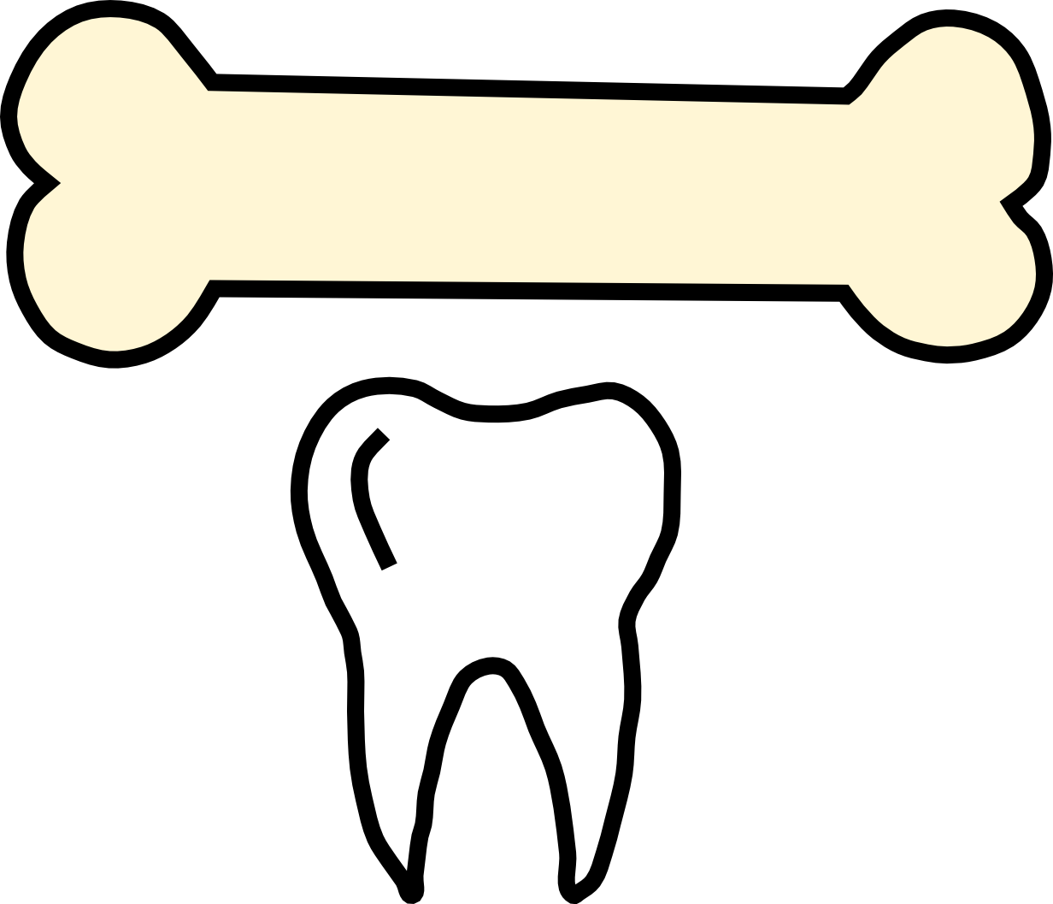
Where are archaeological microbiomes?
Latrines
Paleofeces
Bones & teeth
Dental calculus
Preserved specimens
Pottery
Gut
Oral
Other body sites
Parasites
Food/Drink
Decomposition
emojis from openmoji.org

Slide 35
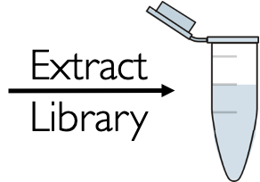

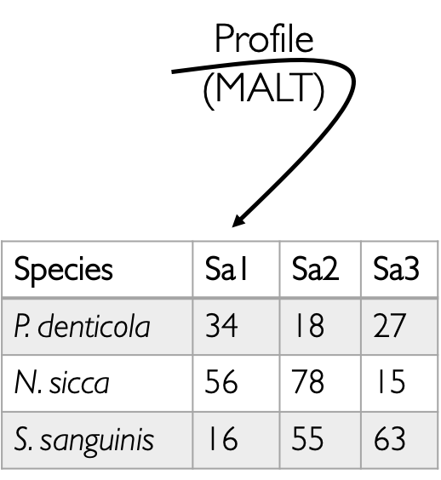
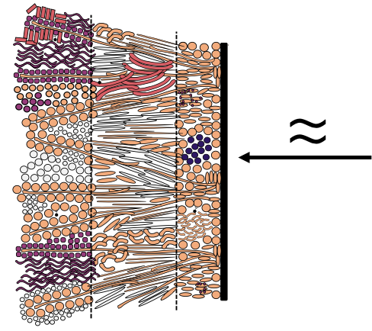
How do we study microbiomes?

Slide 36
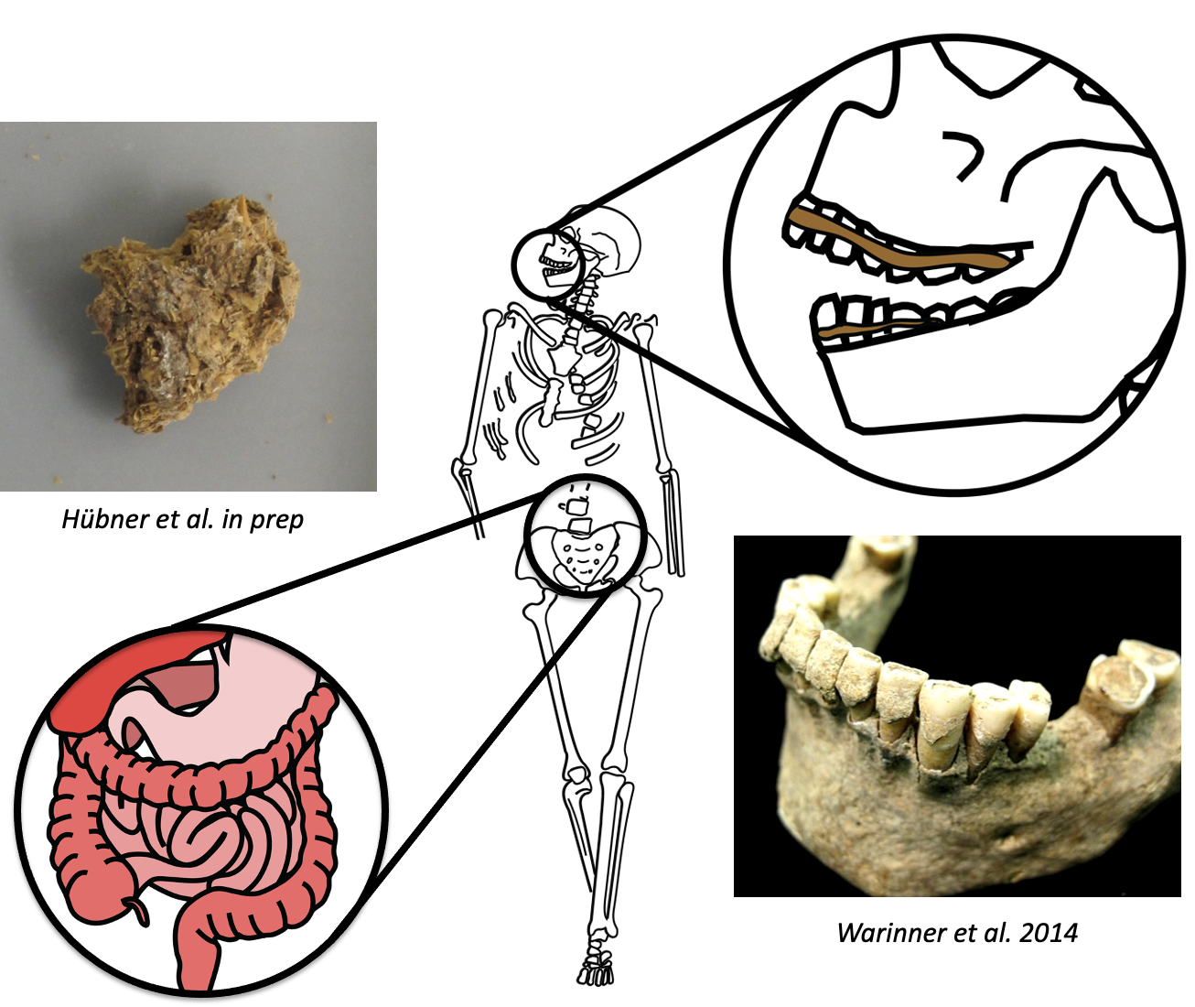
Dental calculus and paleofeces are common ancient human microbiomes

Slide 37
Ancient dental calculus...
Mineralized dental plaque
associated diseases: dental cavities, periodontitis
Ubiquitous in archaeological record
Highly stable human microbiome
across time
across geography
Historic dental calculus (~200 years old)

Slide 38
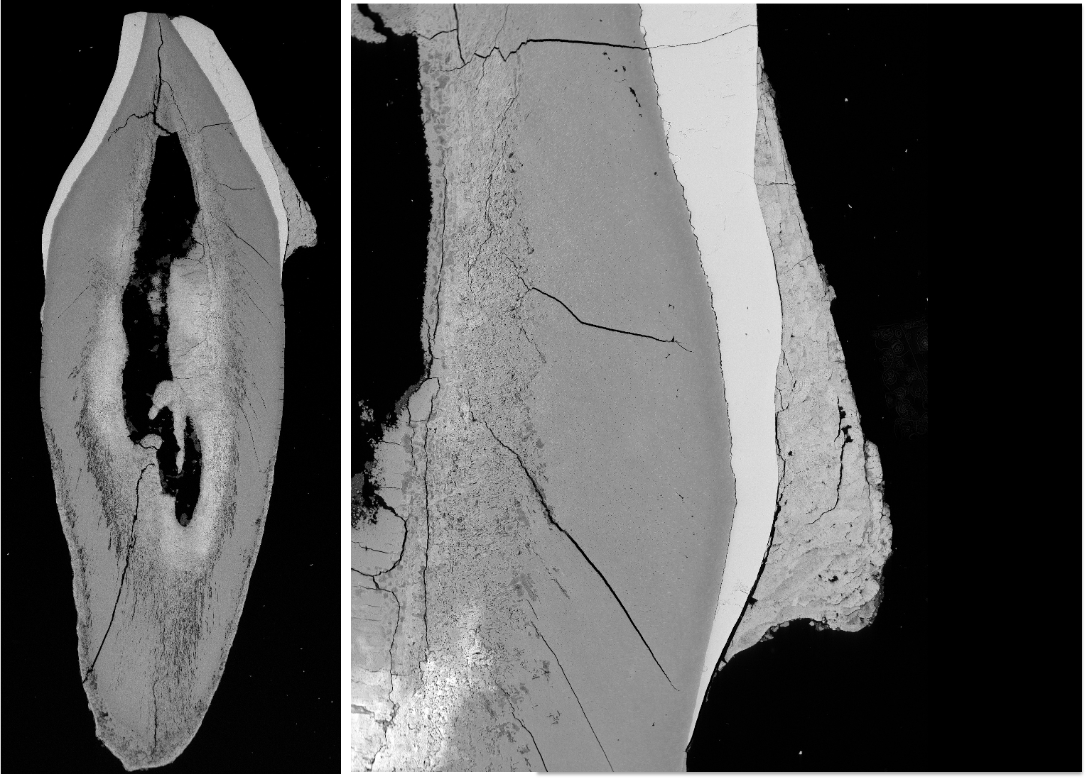
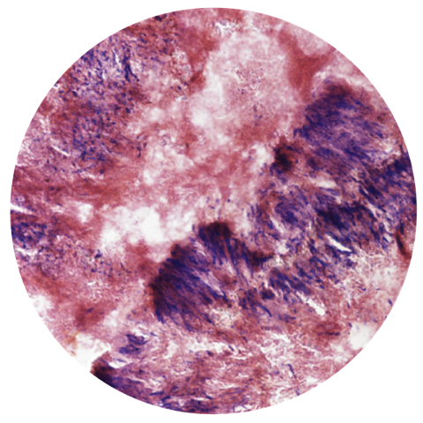
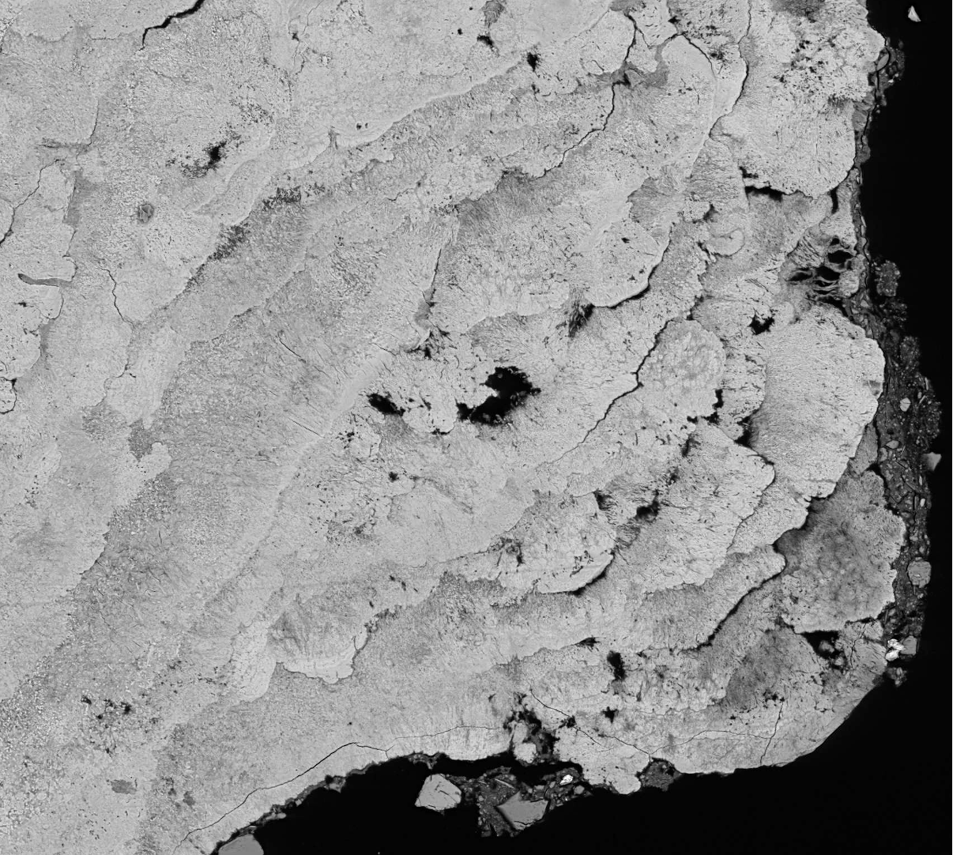
Ancient dental calculus looks like modern dental plaque

Slide 39
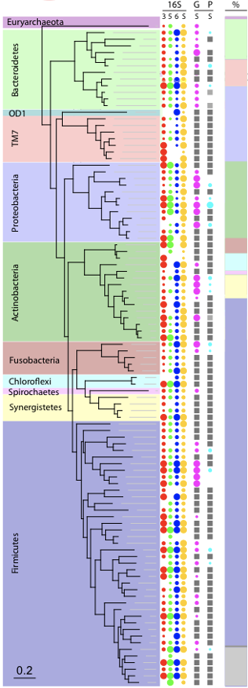
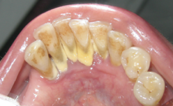
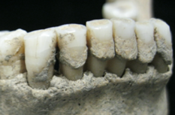
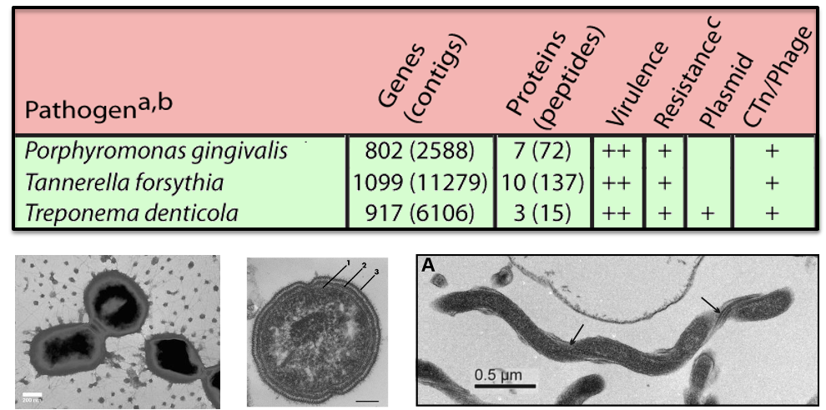
Ancient dental calculus resembles modern dental plaque

Slide 40
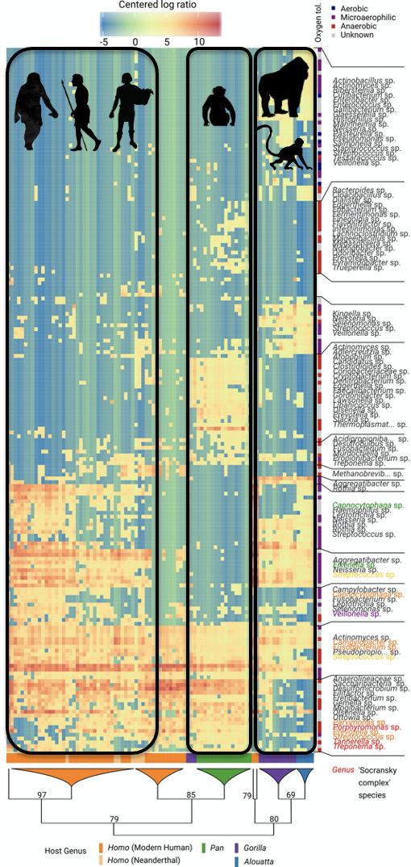
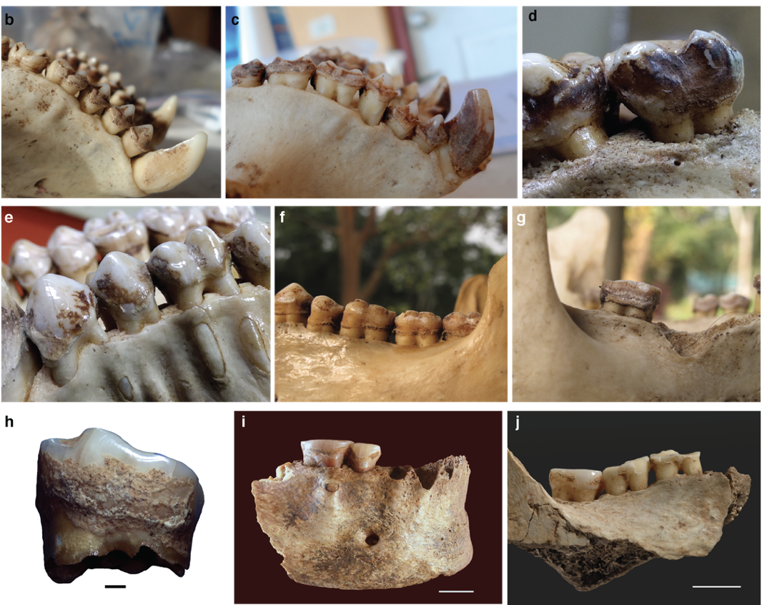
Calculus microbiomes are conserved through time
Modified from Fellows Yates, et al. 2021 PNAS

Slide 41
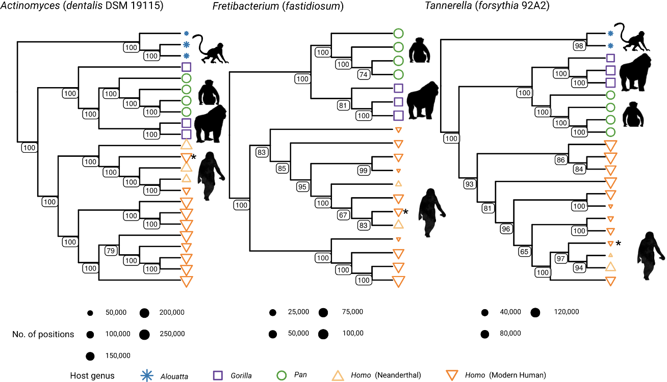
Microbial species evolution traces host evolution
Modified from Fellows Yates, et al. 2021 PNAS

Slide 42
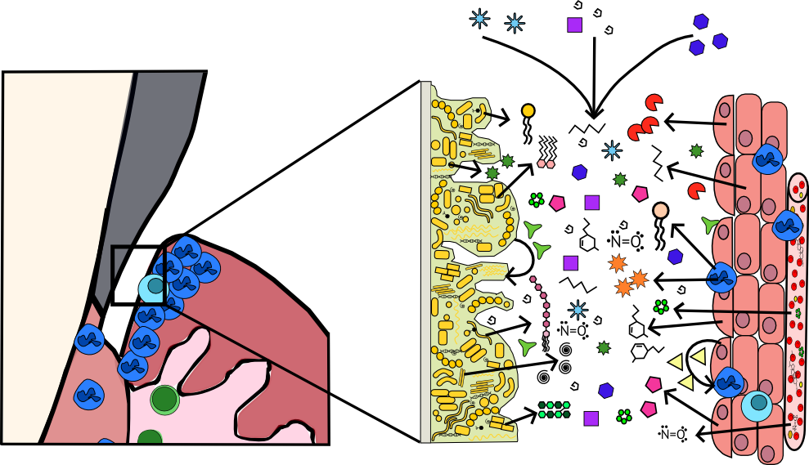
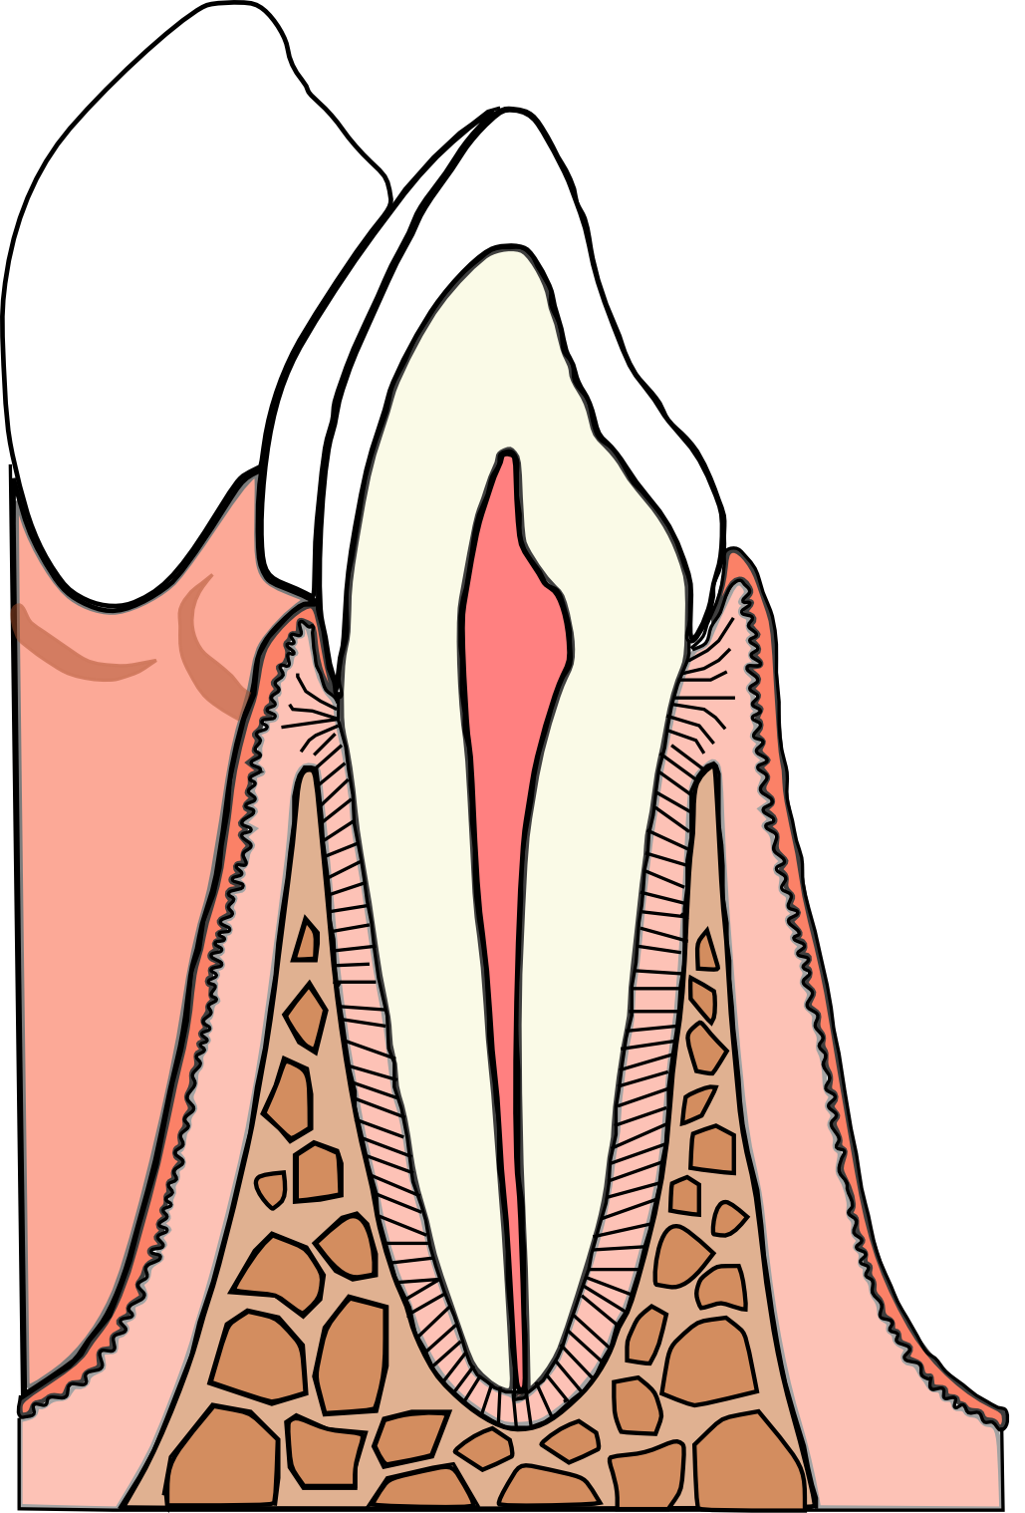
Biofilms are metabolically active
Saliva
Proteins/Metabolites
Plaque
Gingiva

Slide 43
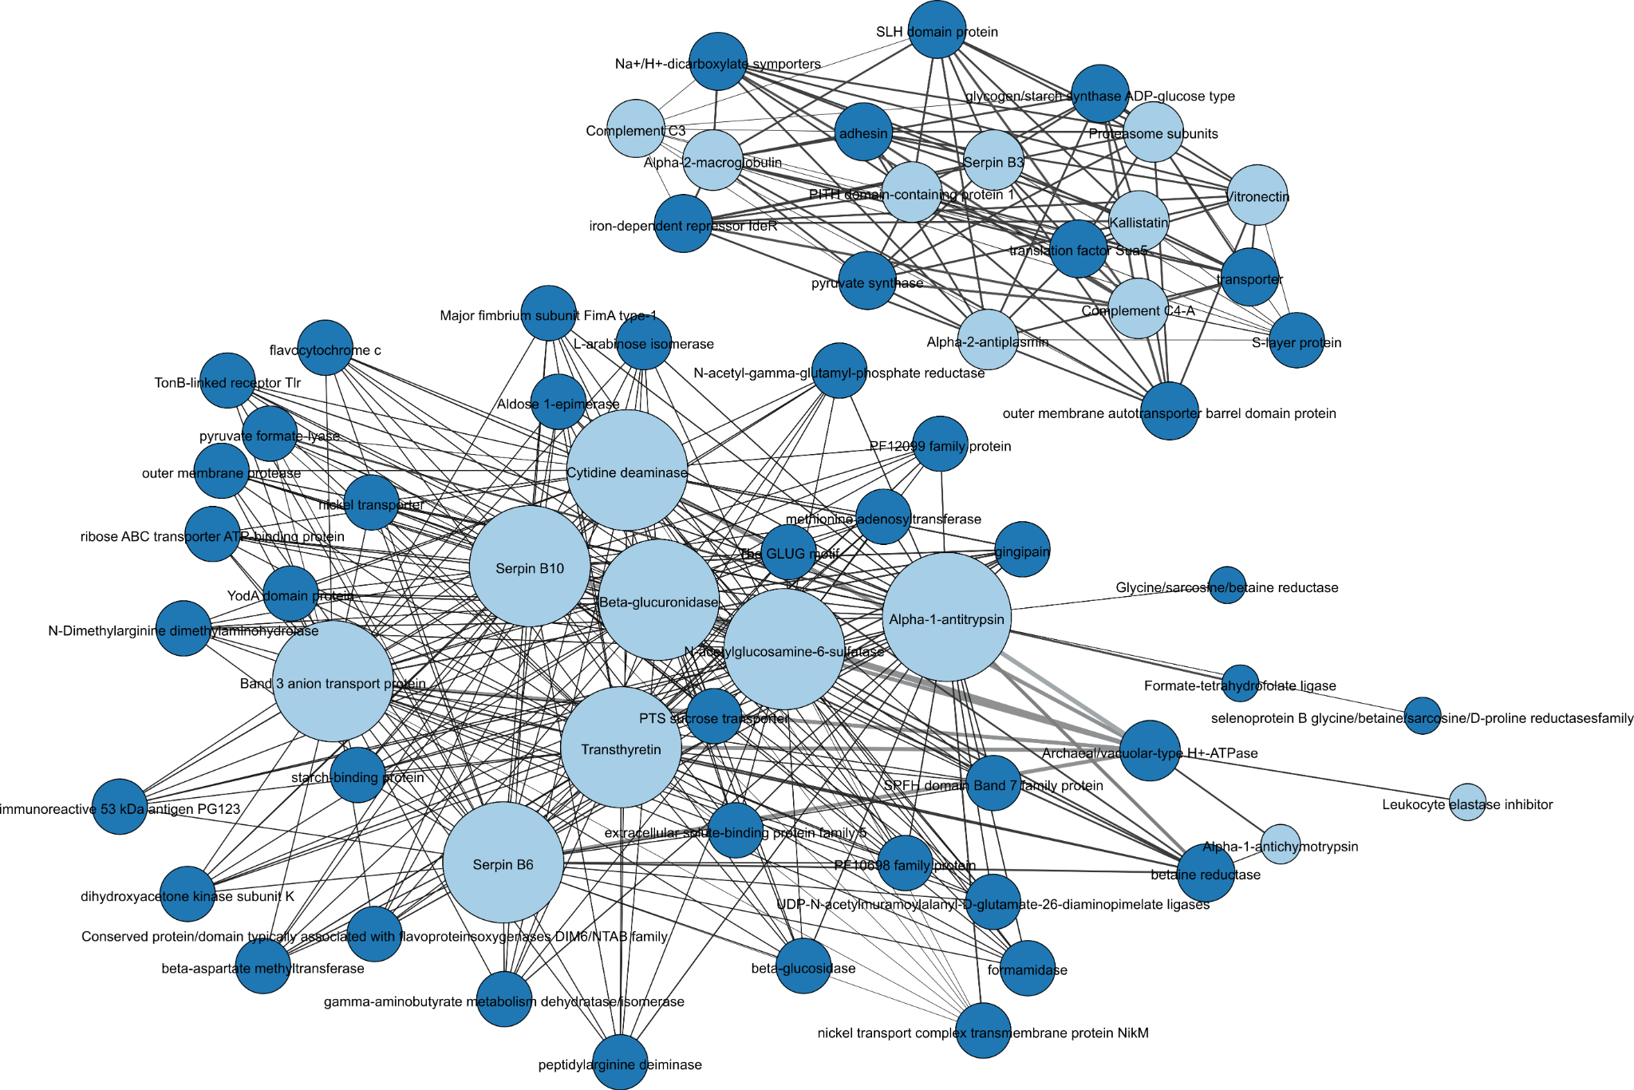
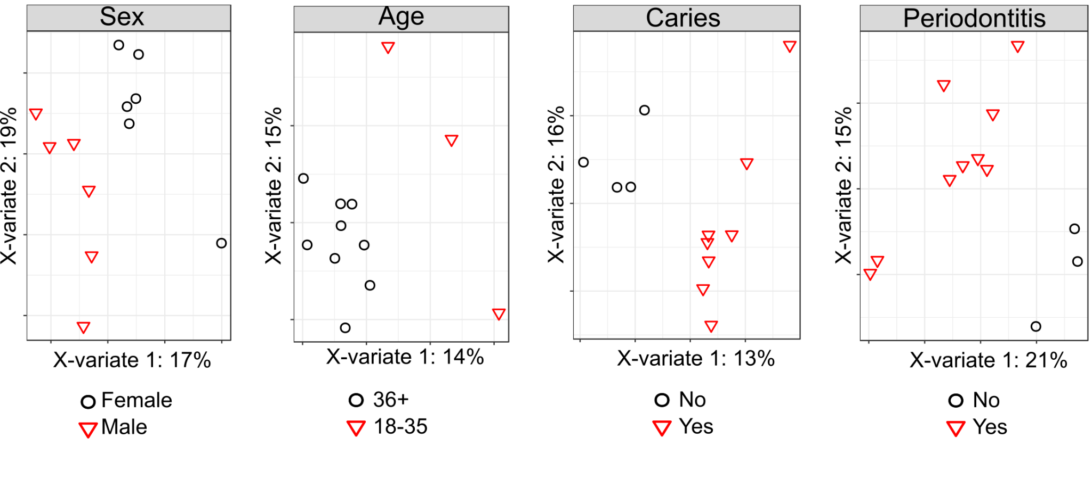
Proteins and metabolites preserve in ancient dental calculus
Modified from Velsko, et al. 2019 Microbiome
Modified from Velsko, et al. 2017 Metabolomics

Slide 44
Paleofeces
Feces preserved under exceptional conditions
very dry (arid, salty)
Associated with many inflammatory disorders
diseases of civilization/industrialization
Uncommon in archaeological record
Highly variable human microbiome

Slide 45
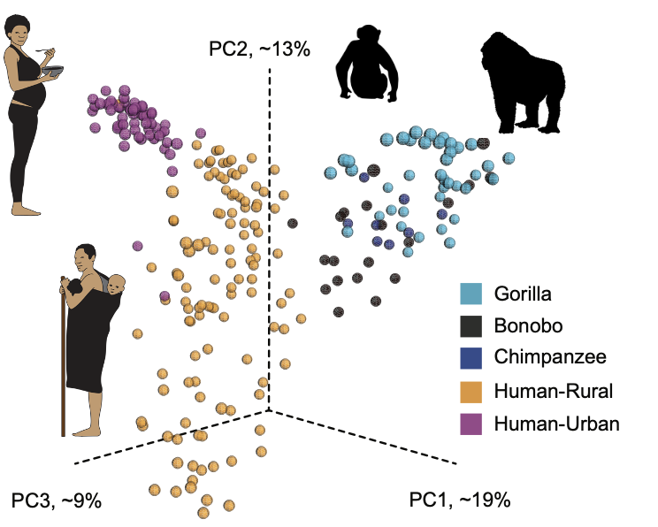
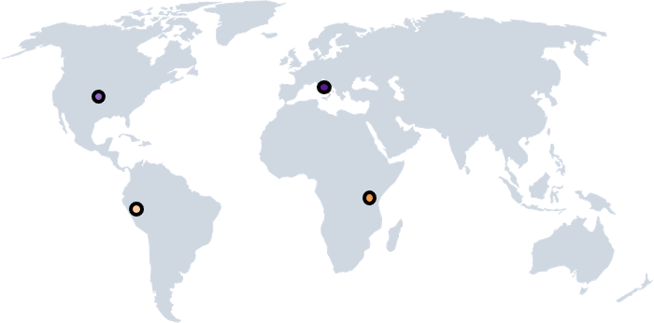
Rural and urban gut microbiomes differ

Slide 46
Paleofeces species composition
When do changes happen?
What drives changes?

Slide 47
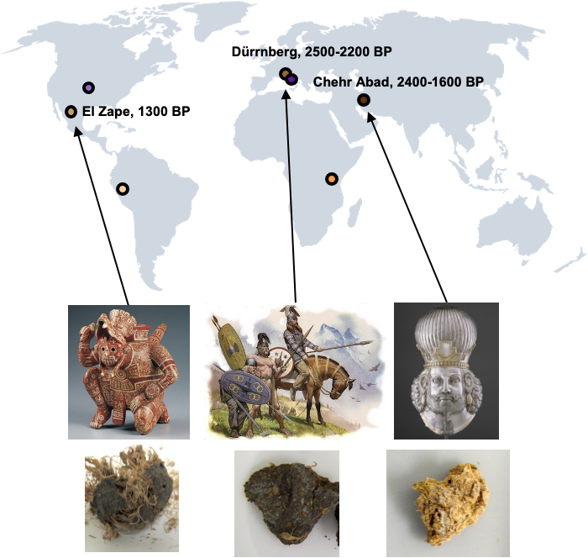

Slide 48
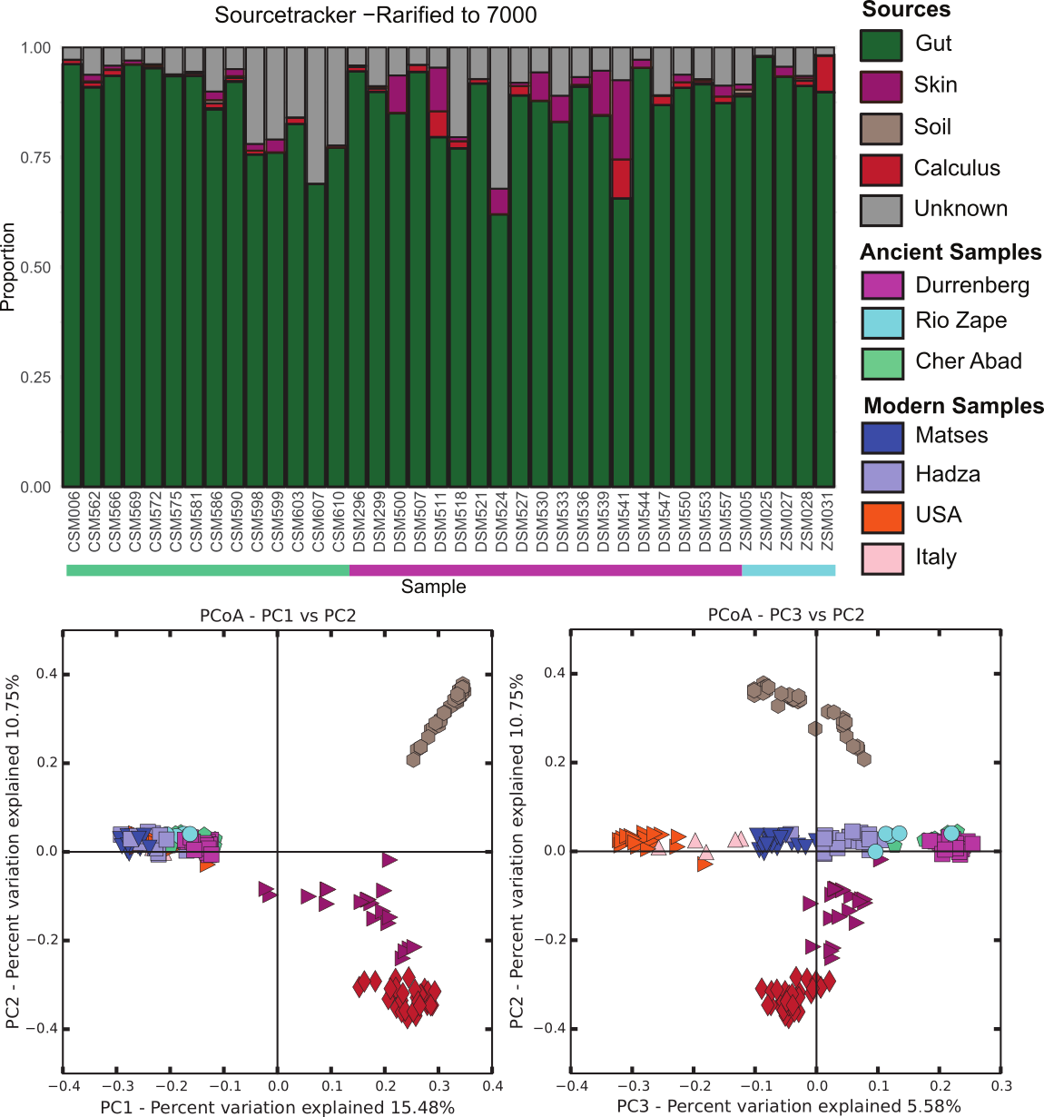
Well-preserved paleofeces resemble modern gut microbiomes

Slide 49
Well-preserved paleofeces resemble traditional food producer gut microbiomes

Slide 50
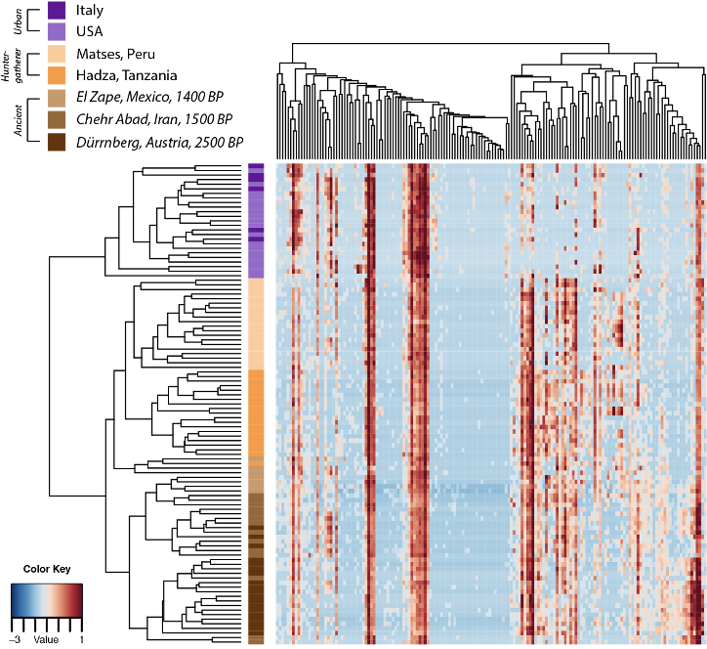
Modern guts lack species found in rural gut and paleofeces microbiomes

Slide 51
Microbiome take-home points
Microbiomes
Preserve in the archaeological record
Contain information about
Microbial taxonomy
Microbial activity (proteins/metabolites)
Reflect host changes
Help us understand historic health and disease
Long-term changes to human condition

Slide 52
Notes:
I added an intro slide to keep things cohesive

Slide 53






Dietary microbes

Slide 54
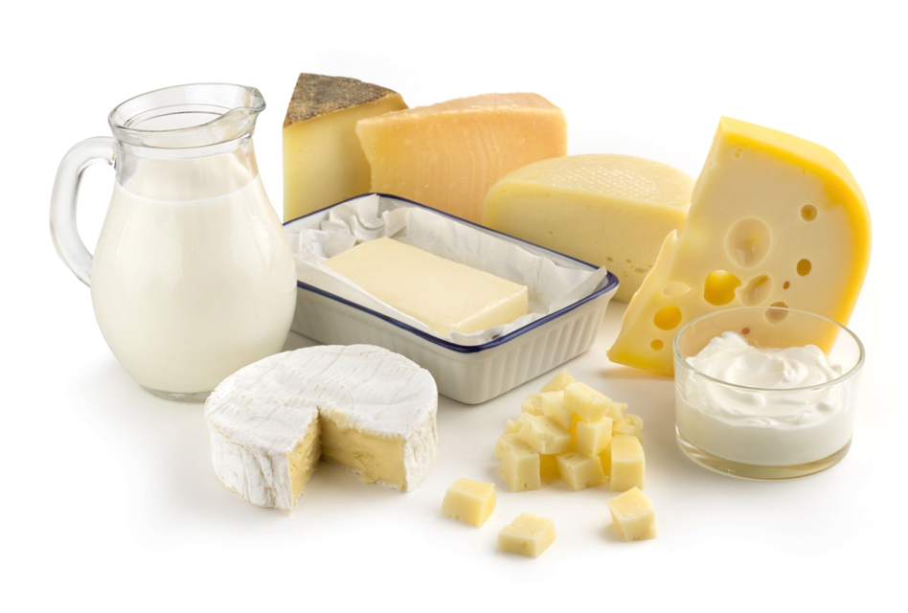
The dairy mystery
Notes:
A lot of people around the world consume dairy as a large part of their diet. As infants, we all produce lactose, to digest lactase, but we gradually stop producing this as we grow up, which is genetically determined so it has nothing to do with our diet. Yet, a lot of people still consume dairy.

Slide 55
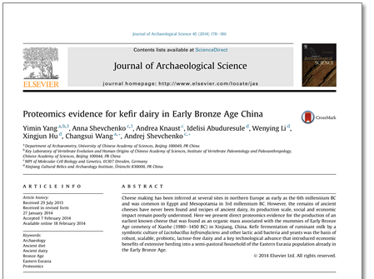
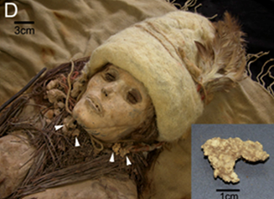
The dairy mystery
Notes:
We also find evidence of dairy and dairy consumption in the archaeological record.

Slide 56
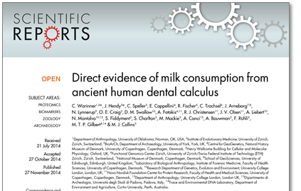
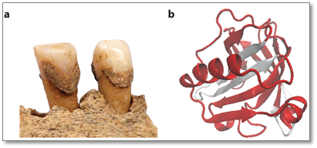
The dairy mystery
Notes:
We also find evidence of dairy and dairy consumption in the archaeological record.

Slide 57
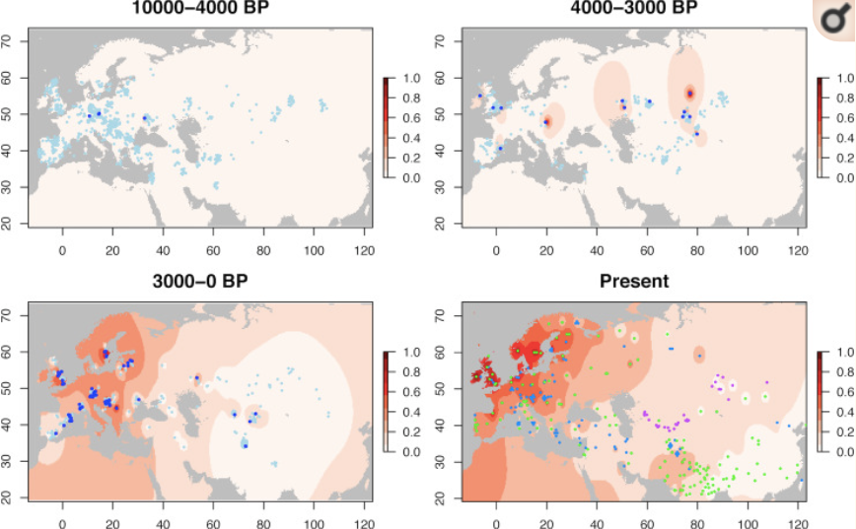
Lactase persistence
Segurel et al. 2019 PLoS Biol.
Notes:
An allele that’s been found to be linked to LP. In general, it’s not that common in areas that consume a lot of dairy.

Slide 58
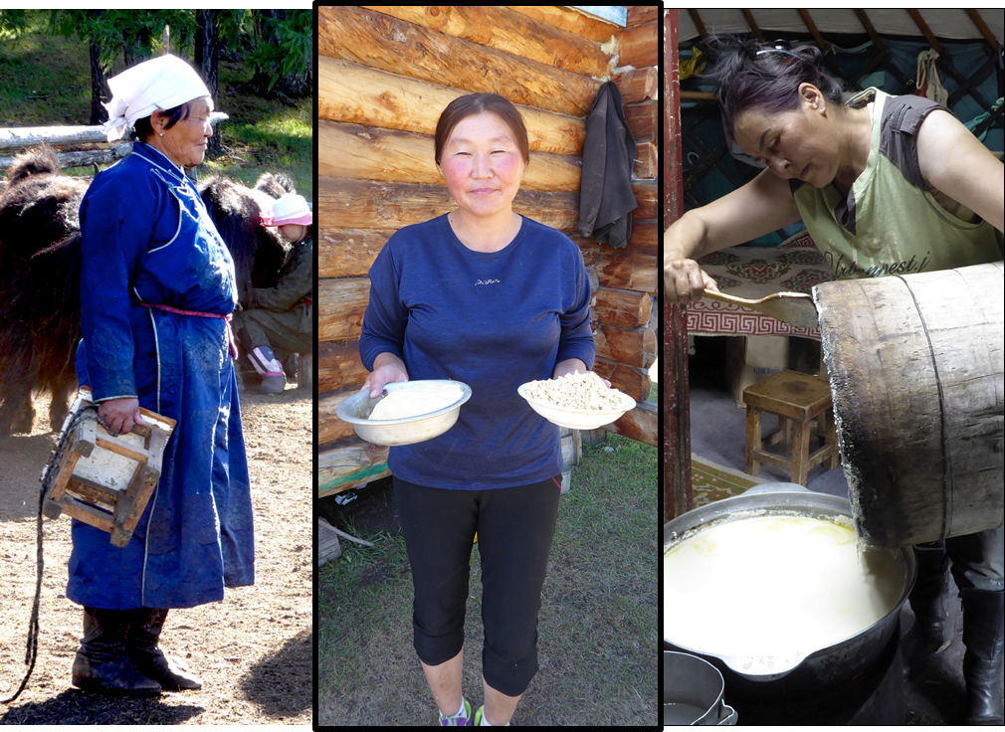
Microbes? Cooking?
Notes:
Microbes and cooking can remove lactose from dairy products, could this be it? No, we’ve found out that e.g. a lot of the dairy products consumed in Mongolia still contain a lot of lactose.

Slide 59

The gut microbiome?
Notes:
The gut is what causes the issues with lactose intolerance in the first place. What happens if it adapts to a dairy-based diet?

Slide 60
The dairy mystery
Archaeogenetics
Palaeoproteomics
Ethnography
Modern microbiology
Archaeology...
Stay tuned!
Notes:
No one actually knows how so many people in the world consume dairy without being lactase persistent yet. Ongoing research, combining many different fields to try and get a holistic view.

Slide 61
Overall conclusions slide
Microbes are awesome.
Microbes are abundant in the archaeological record
They can be identified with various biomolecular techniques
They can tell us about multiple aspects of the human past
Zandra Fagernäs
zandra_fagernaes@eva.mpg.de
@zandra_fagernaes
Irina Velsko
irina_marie_velsko@eva.mpg.de
@irina_marie_velsko
Email:
Mattermost:

Slide 62
Discussion questions
Are there historically recorded diseases that you might want to investigate with aDNA? What are they?
Can you think of places to find ancient microbes other than the ones we presented?
How can studying ancient microbes help us with modern medicine and microbiology?
How can ancient animal samples be used to study the origin of zoonotic (animal-derived) diseases?
How can studying microbiomes help us understand human lifestyle changes?
How have the words used to explain/describe infectious disease evolved over time?

